Slide 1


Slide 2

8
MONEY, THE PRICE LEVEL,
AND INFLATION
Notes:
Notes and teaching tips: 4, 8, 9, 13, 15, 17, 26, 28, 31, 44, 45, 65, 67, and 68.
To view a full-screen figure during a class, click the expand button.
To return to the previous slide, click the shrink button.
To advance to the next slide, click anywhere on the full screen figure.
Applying the principles of economics to interpret and understand the news is a major goal of the principles course. You can encourage your students in this activity by using the two features: Economics in the News and Economics in Action.
(1) Before each class, scan the news and select two or three headlines that are relevant to your session today. There is always something that works. Read the headline and ask for comments, interpretation, discussion. Pose questions arising from it that motivate today’s class. At the end of the class, return to the questions and answer them with the tools you’ve been explaining.
(2) Once or twice a semester, set an assignment, for credit, with the following instructions:
(a) Find a news article about an economic topic that you find interesting.
(b) Make a short bullet-list summary of the article.
(c) Write and illustrate with appropriate graphs an economic analysis of the key points in the article.
Use the Economics in the News features in your textbook as models.

Slide 3
After studying this chapter, you will be able to:
Define money and describe its functions
Explain the economic functions of banks
Describe the structure and functions of the Bank of Canada
Explain how the banking system creates money
Explain what determines the quantity of money and interest rates
Explain how the quantity of money influences the price level and the inflation rate
Copyright © 2019 Pearson Canada Inc.

Slide 4
What is Money?
Money is any commodity or token that is generally acceptable as a means of payment.
A means of payment is a method of settling a debt.
Money has three other functions:
Medium of exchange
Unit of account
Store of value
Notes:
The defining characteristic of money Adam Smith wrote, “Money is a commodity or token that everyone will accept in exchange for the things they have to sell.” Most people have interpreted this statement as defining money as the medium of exchange. That interpretation is wrong. Smith is defining money as the means of payment. Money is a commodity or token that everyone will accept as payment for the things they have to sell.
When Michael was at the start of his career, he had the enormous good fortune to meet Anna Schwartz, Milton Friedman, and a group of other leading monetary economists. It was during the late 1960s when the monetarist debate was alive and well and people were still arguing about whether the demand for money was interest inelastic (as the monetarists claimed) or almost perfectly elastic (as the Keynesians claimed). Anna made a remark that for him was one of those defining moments. She said money is the means of payment. Nothing else performs this function. It is unique to money. Many things serve as a medium of exchange, unit of account, or store of value, but money alone serves as the means of payment—the means of settling a debt so that there is no remaining obligation between the parties to a transaction.

Slide 5
What is Money?
Medium of Exchange
A medium of exchange is an object that is generally accepted in exchange for goods and services.
In the absence of money, people would need to exchange goods and services directly, which is called barter.
Barter requires a double coincidence of wants, which is rare, so barter is costly.

Slide 6
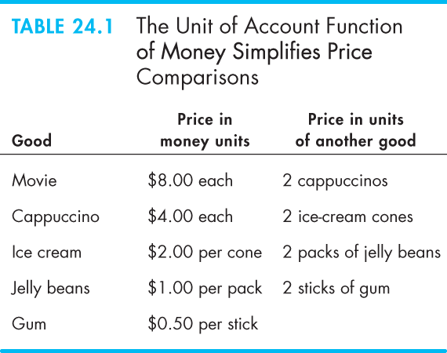

What is Money?
Unit of Account
A unit of account is an agreed measure for stating the prices of goods and services.
Table 8.1 illustrates how money simplifies comparisons.
Store of Value
As a store of value, money can be held for a time and later exchanged for goods and services.

Slide 8
What is Money?
Money in Canada Today
Money in Canada consists of
Currency
Deposits at banks and other depository institutions
Currency is the notes and coins held by individuals and businesses.
Notes:
Fiat money. To get across the idea of money, take a coloured piece of paper and cut it to the same size as a $20 bill. Then take the paper into class along with a $20 bill. Ask the students why one piece of paper has value and the other does not. Is there anything intrinsically more valuable about the $20 bill? If not, why won’t someone in class exchange his or her old wrinkled piece of Bank of Canada paper with writing on it for the nice new piece you offer?
The contrast between money in economics and money in everyday language. It can be helpful to emphasize that “money” is a technical term in economics that has a precise meaning and that differs from its looser usages in every day language. For example, an economist would not say “Bill Gates makes a lot of money.” Rather, the economist would say “Bill Gates earns a large income.” An interesting exercise is to have students think of statements containing the word “money” that make complete sense in normal language but that misuse the word in its precise economic sense, and to get them to explain why.
A picky point. The textbook is careful in its use of the terms “quantity of money” and “money supply”. The money supply is the relationship between the quantity of money supplied and the interest rate, other things remaining the same. It parallels the demand for money. Although this point might seem picky, you can help your students by using this same language convention. Everyday usage over uses the term “money supply.”

Slide 9
What is Money?
Official Measures of Money
The two main official measures of money in Canada are M1 and M2.
M1 consists of currency held by individuals and businesses plus chequable deposits owned by individuals and businesses.
M2 consists of M1 plus all other deposits─non-chequable deposits and fixed term deposits.
Notes:
Get the class involved in figuring out what money is. To involve the students in the process of determining what money is, after noting its definition and three functions, ask them what they think should be counted as money. List the suggestions on the board before commenting on them. Coins and currency will certainly be mentioned. Usually each class has a few members who have read the text and will suggest checkable deposits. Almost always you will obtain some not-so-excellent answers, ranging from gold to shares of stock to credit cards. The point of this exercise is to obtain these incorrect answers because they give you a chance to discuss why these items are not money. Without ridiculing the wrong answers, you can poke fun at some of the suggestions. (Point out that students rarely pay for books by giving the bookstore shares of Bombardier stock and asking for change in BCE stock.) By being involved and having to think, the students emerge with a stronger grasp of why money is measured as it is.

Slide 10
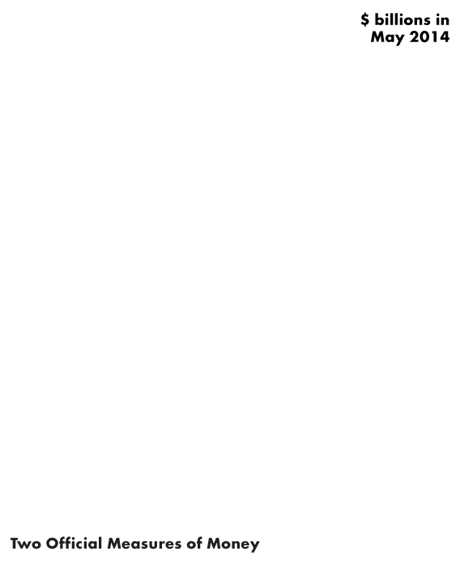
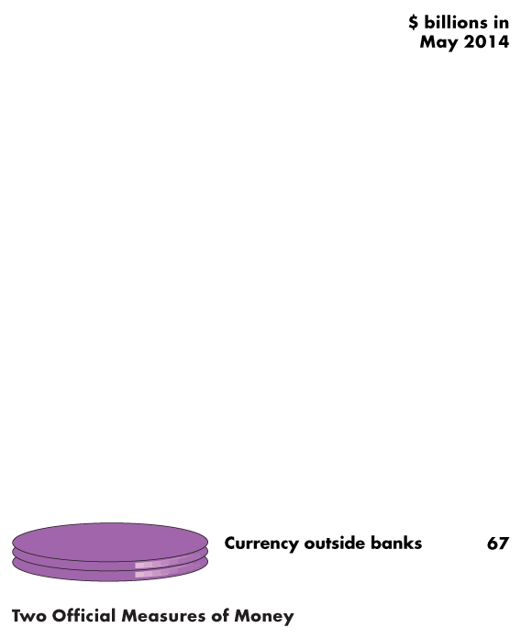
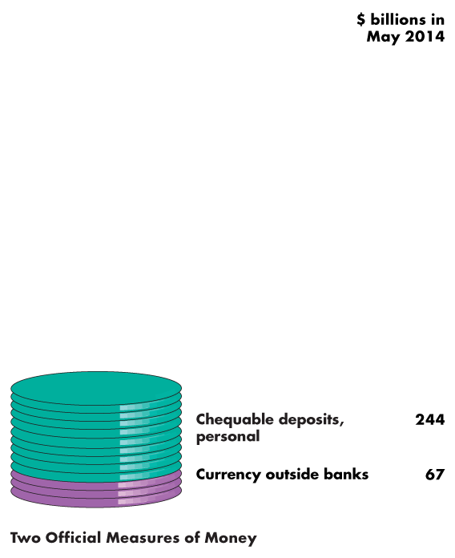
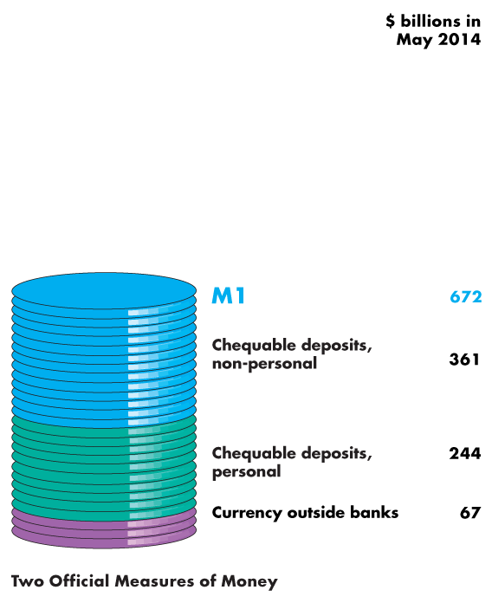
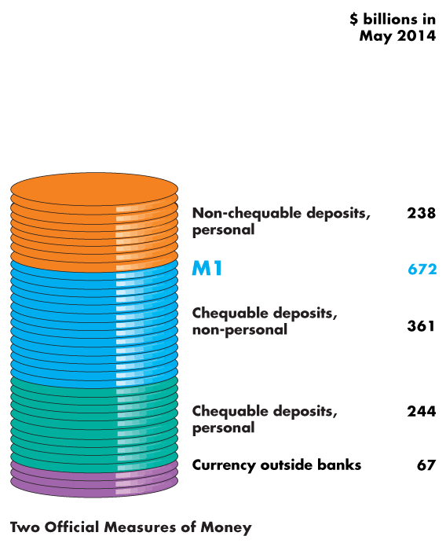
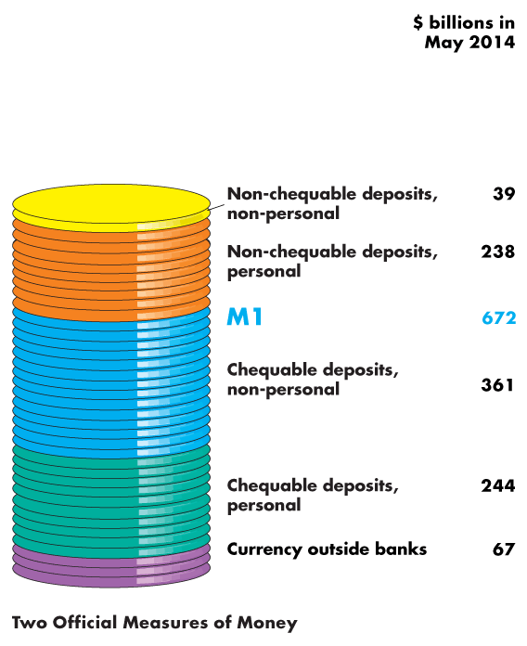
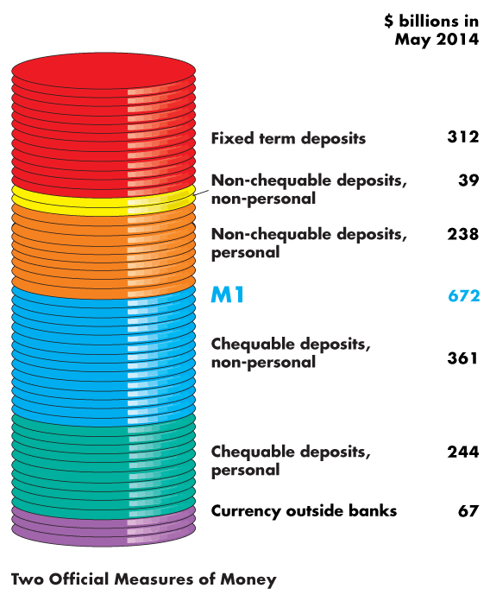
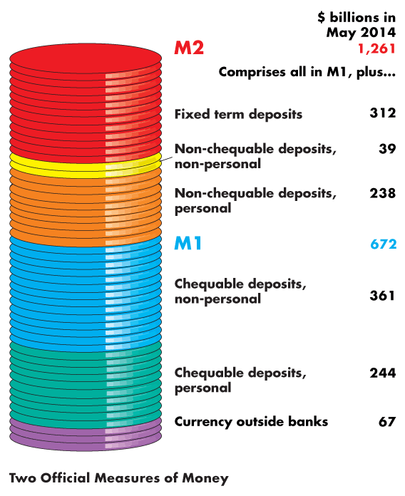

What is Money?
The figure illustrates the composition of M1 …
and M2.
It also shows the relative magnitudes of the components.

Slide 12
What is Money?
Are M1 and M2 Really Money?
All the items in M1 are means of payment. They are money.
Some savings deposits in M2 are not means of payments—they are called liquid assets.
Liquidity is the property of being instantly convertible into a means of payment with little loss of value.
Deposits are money, but cheques are not—a cheque is an instruction to a bank to transfer money.
Credit cards are not money. A credit card enables the holder to obtain a loan, but it must be repaid with money.

Slide 13
Depository Institutions
A depository institution is a firm that takes deposits from households and firms and makes loans to other households and firms.
Types of Depository Institutions
Deposits at three institutions make up the nation’s money. They are:
Chartered banks
Credit unions and caisses populaires
Trust and mortgage loan companies
Notes:
Students usually have bank accounts, but often they have never fully thought through what banks do, how they do it, or what the differences are between banks and other deposit-taking institutions, so what tends to strike instructors as rather dry descriptive material can be interesting to students. It is worth being explicit about the fact, which students tend to be very aware of, that in practice chartered banks earn income not only by the spread between their deposit and lending rates, but also by charging fees for their services. The text focuses on the role of depository institutions as a source of credit creation; for most students, like most customers, their most important function is actually facilitating the payment process, and a little discussion on that (and how relatively cheap it is) can also engage students.

Slide 14
Depository Institutions
Chartered Banks
A chartered bank is a private firm, chartered under the Bank Act of 1991 to receive deposits and make loans.
Credit Unions and Caisses Populaires
A credit union is a cooperative organization that operates under the Cooperative Credit Association Act of 1991 and that receives deposits from and makes loans to its members.
A caisse populaire is a similar type of institution that operates in Quebec.

Slide 15
Depository Institutions
What Depository Institutions Do
To goal of any bank is to maximize the wealth of its owners.
To achieve this objective, the interest rate at which it lends exceeds the interest rate it pays on deposits.
But the banks must balance profit and prudence:
Loans generate profit.
Depositors must be able to obtain their funds when they want them.
Notes:
Classroom activity
Check out At Issue: Fractional-Reserve Banking versus 100 Percent Reserve Banking

Slide 16
Depository Institutions
A chartered bank puts the depositors’ funds into four types of assets:
Reserves—notes and coins in its vault or its deposit at the Bank of Canada
Liquid assets—Canadian government Treasury bills and commercial bills
Securities—longer–term Canadian government bonds and other bonds such as mortgage-backed securities
Loans—commitments of fixed amounts of money for agreed-upon periods of time

Slide 17
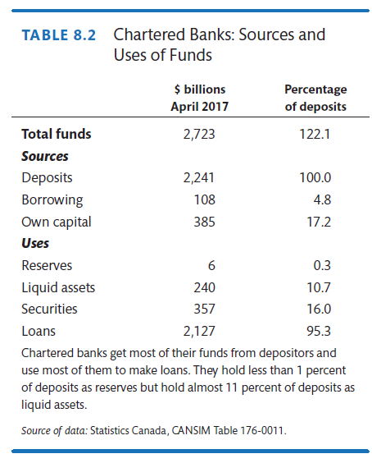
Depository Institutions
Table 8.2 shows the sources and uses of funds in all chartered banks in April 2017.
Notes:
Classroom activity
Check out Economics in Action: Canadian and U.S. Banks Compared

Slide 19
Depository Institutions
Economic Benefits Provided by Depository Institutions
Depository institutions make a profit from the spread between the interest rate they pay on their deposits and the interest rate they charge on their loans.
Depository institutions provide four benefits:
Create liquidity
Pool risk
Lower the cost of borrowing
Lower the cost of monitoring borrowers

Slide 20
Depository Institutions
How Depository Institutions Are Regulated
Depository institutions engage in risky business.
To make the risk of failure small, depository institutions are required to hold levels of reserves and owners’ capital equal to or that surpass the ratios laid down by regulation.
If a Canadian bank fails, deposits are guaranteed up to $100,000 per depositor per bank by the Canada Deposit Insurance Corporation.
Provincial government agencies regulate credit unions and caisses populaires.

Slide 21
Depository Institutions
Financial Innovation
The aim of financial innovation—the development of new financial products—is to lower the cost of deposits or to increase the return from lending.
Two influences on financial innovation are:
Economic environment
Technology

Slide 22
The Bank of Canada
The Bank of Canada is the central bank of Canada.
A central bank is the public authority that regulates a nation’s depository institutions and control the quantity of money.
The Bank of Canada is:
Banker to the banks and government
Lender of last resort
Sole issuer of bank notes

Slide 23
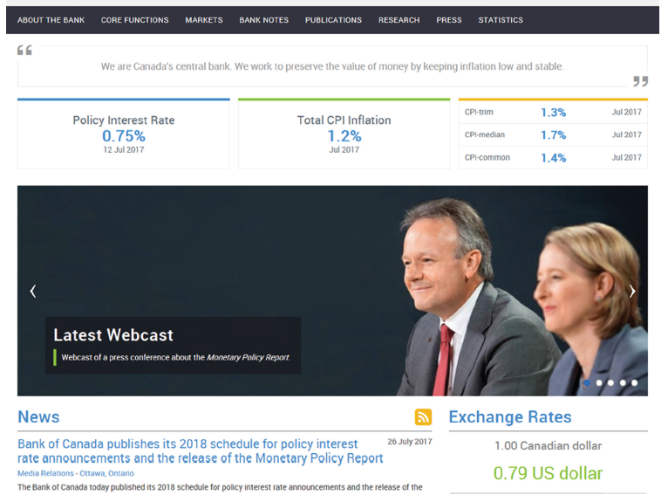

Slide 24
The Bank of Canada
Banker to Banks and Government
The Bank of Canada accepts deposits from depository institutions that make up the payments system and the government of Canada.
Lender of Last Resort
The Bank of Canada is the lender of last resort, which means that it stands ready to make loans when the banking system as a whole is short of reserves.
Banks lend and borrow reserves from other banks in the overnight loans market.

Slide 25
The Bank of Canada
Sole Issuer of Bank Notes
The Bank of Canada is the only bank that is permitted to issue bank notes. The Bank of Canada has a monopoly on this activity.
The Bank of Canada’s Balance Sheet
The Bank of Canada’s assets are government securities and last-resort loans to banks.
Its liabilities are Bank of Canada notes and deposits of banks and the government.

Slide 26
The Bank of Canada
The Bank of Canada’s Balance Sheet
On the Bank’s balance sheet, the largest and most important asset is Canadian government securities.
The most important liabilities are Bank of Canada notes in circulation and banks’ deposits.
Notes:
It is useful to look at the Bank of Canada’s balance sheet (available on its excellent Web site). It shows very quickly that loans to banks usually are a trivial portion of the Bank of Canada’s assets. Of the Bank of Canada’s theoretical three tools, only open market operations really matter and there is no harm in being blunt about this. Students can easily see why required reserve ratio changes would work, but also can see quickly how discontinuous and disruptive they would be. Tell students that (a) many industrialized countries no longer bother with required reserve ratios at all, and (b) changes in required reserve ratios are normally only used as monetary policy tools in developing countries without capital markets in which open market operations would be possible. The discount rate looks like it ought to matter more, and certainly changes in it are announced, but explain that it is in practice a signal: banks only borrow from the Bank of Canada as a last resort. Why? Because banks believe that if they borrow from the Bank of Canada, that will be interpreted as meaning that they cannot borrow from any other source, so they are in very bad trouble. So what actually matters is the Bank of Canadaeral Funds Rate, which the Bank of Canada can influence very strongly by changing the supply of reserves by Open Market Operations. The distinction between the deposit multiplier and the money multiplier is somewhat subtle; the key issue is not only that there may be a currency drain, but that banks do sometimes hold excess reserves, or move excess reserves into alternate income-generating assets rather than loans.

Slide 27
The Bank of Canada
Monetary Base
The liabilities of the Bank of Canada (plus coins issued by the Canadian Mint) form the monetary base.
The monetary base is the sum of Bank of Canada notes outside the Bank of Canada, banks’ deposits at the Bank of Canada, and coins held by households, firms, and banks.
To change the monetary base, the Bank of Canada conducts an open market operation, which is the purchase or sale of government of Canada securities by the Bank of Canada in the open market.

Slide 28
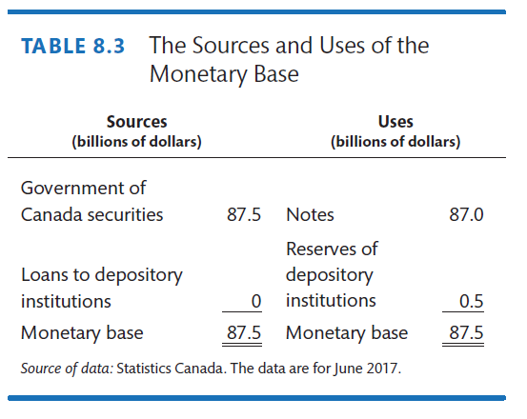
The Bank of Canada
Table 8.3 shows the sources and uses of the monetary base in June 2017.
The Bank of Canada’s assets are the sources of monetary base.
The Bank of Canada’s liabilities are its uses of monetary base.
Notes:
Classroom activity
Check out Economics in Action: The Tale of Two Central Banks

Slide 30
The Bank of Canada
The Bank of Canada’s Policy Tools
To achieve its objectives, the Fed uses three main policy tools:
Open market operations
Bank rate

Slide 31
The Bank of Canada
Open Market Operations
An open market operation is the purchase or sale of government securities by the Bank of Canada from or to a chartered bank or the public.
When the Bank of Canada buys securities, it pays for them with newly created reserves held by the banks.
When the Bank of Canada sells securities, they are paid for with reserves held by banks.
So open market operations influence banks’ reserves.
Notes:
Classroom activity
Check out Economics in the News: A Massive Open Market Operation

Slide 32
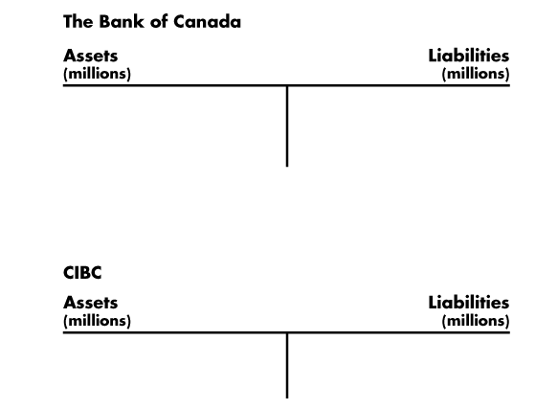
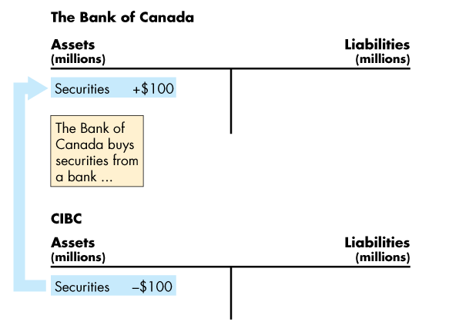
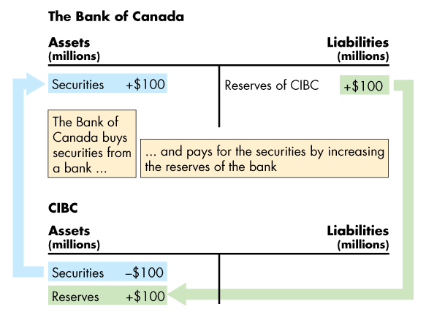
The Bank of Canada
An Open Market Purchase
Figure 8.2 shows the effects of an open market purchase on the balance sheets of the Bank of Canada and CIBC.
The open market purchase increases bank reserves.

Slide 34

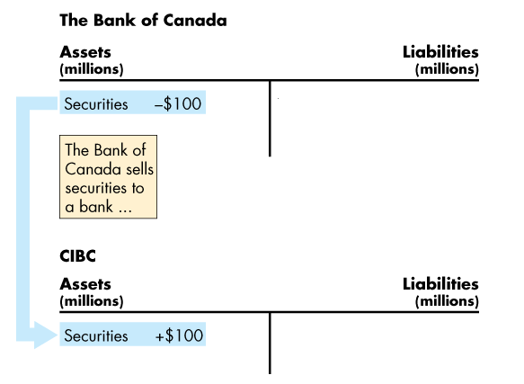
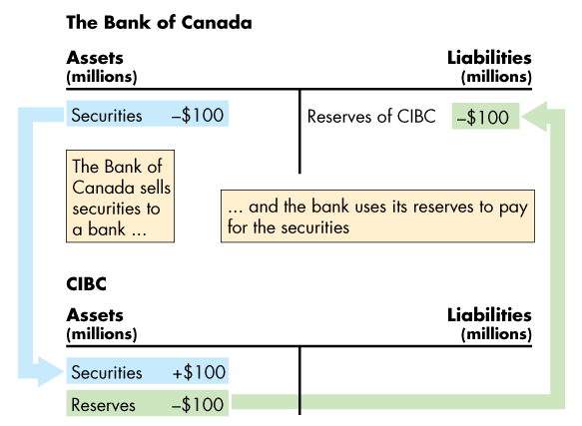
The Bank of Canada
An Open Market Sale
This figure shows the effects of an open market sale on the balance sheets of the Bank of Canada and CIBC.
The open market sale decreases bank reserves.

Slide 36
The Bank of Canada
Bank Rate
The Bank of Canada makes short-term loans, typically one-day loans, to major depository institutions when the banking system is short of reserves.
The interest rate on these loans is called bank rate.
Bank rate acts as an anchor for other short-term interest rates and is closely related to the Bank’s target for the overnight loans rate.

Slide 37
How Banks Create Money
Creating Deposits by Making Loans
Banks create deposits when they make loans and the new deposits created are new money.
The quantity of deposits that banks can create is limited by three factors:
The monetary base
Desired reserves
Desired currency holding

Slide 38
How Banks Create Money
The Monetary Base
The monetary base is the sum of Bank of Canada notes, coins, and banks’ deposits at the Bank of Canada.
The size of the monetary base limits the total quantity of money that the banking system can create because
Banks have desired reserves
Households and firms have desired currency holdings
And both these desired holdings of monetary base depend on the quantity of money.

Slide 39
How Banks Create Money
Desired Reserves
A bank’s actual reserves consists of notes and coins in its vault and its deposit at the Bank of Canada.
The desired reserve ratio is the ratio of the bank’s reserves to total deposits that a bank plans to hold.
The desired reserve ratio exceeds the required reserve ratio by the amount that the bank determines to be prudent for its daily business.

Slide 40
How Banks Create Money
Desired Currency Holding
People hold some fraction of their money as currency.
So when the total quantity of money increases, so does the quantity of currency that people plan to hold.
Because desired currency holding increases when deposits increase, currency leaves the banks when they make loans and increase deposits.
This leakage of reserves into currency is called the currency drain.
The ratio of currency to deposits is the currency drain ratio.

Slide 41
How Banks Create Money
The Money Creation Process
Money creation process begins with an increase in the monetary base.
The Bank of Canada conducts an open market operation in which it buys securities from banks.
The Bank of Canada pays for the securities with newly created bank reserves.
Banks now have more reserves but the same amount of deposits, so they have excess reserves.
Excess reserves = Actual reserves – desired reserves.

Slide 42
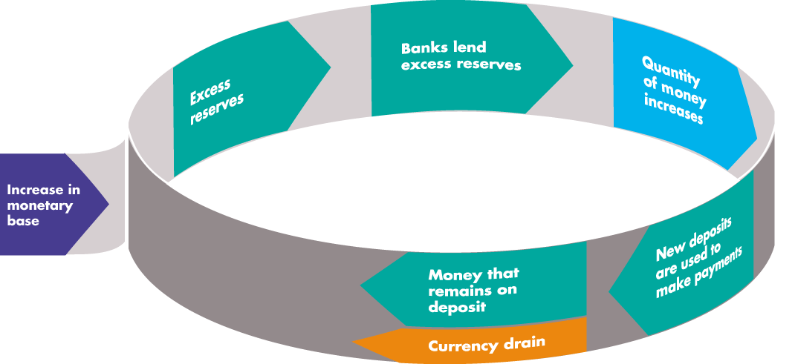
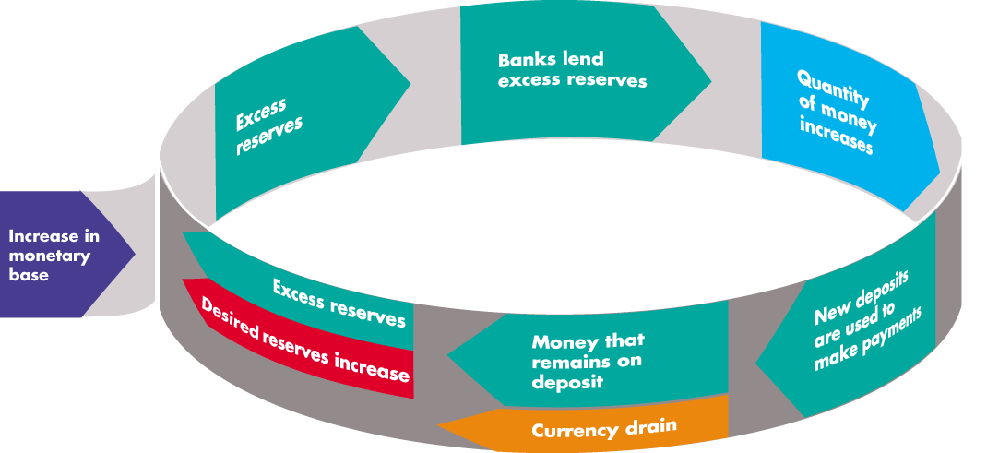
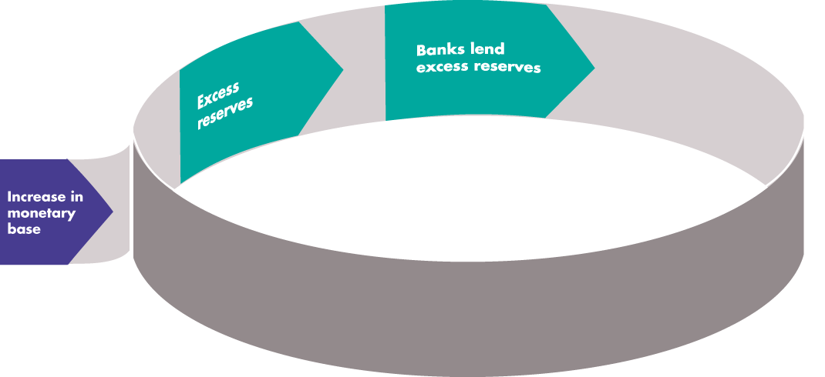
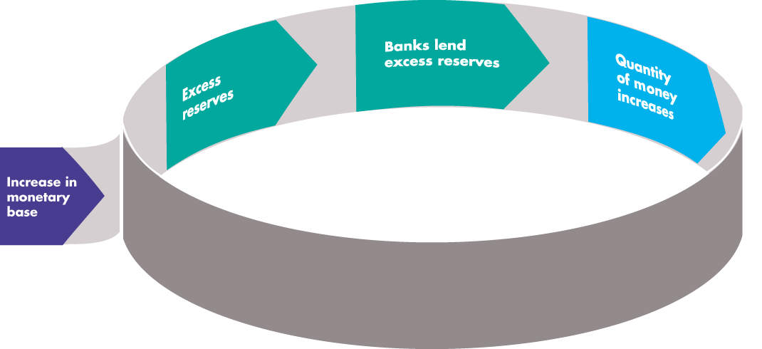
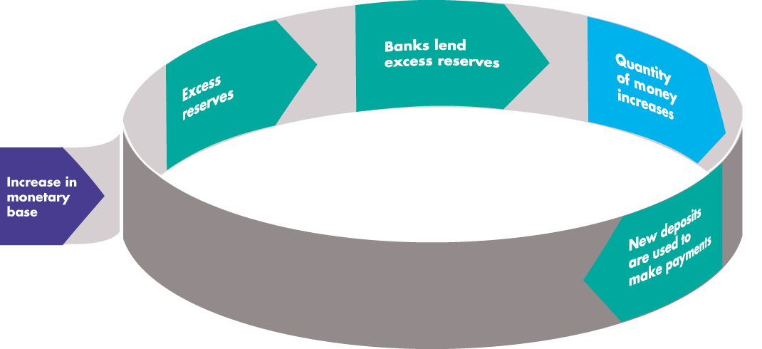
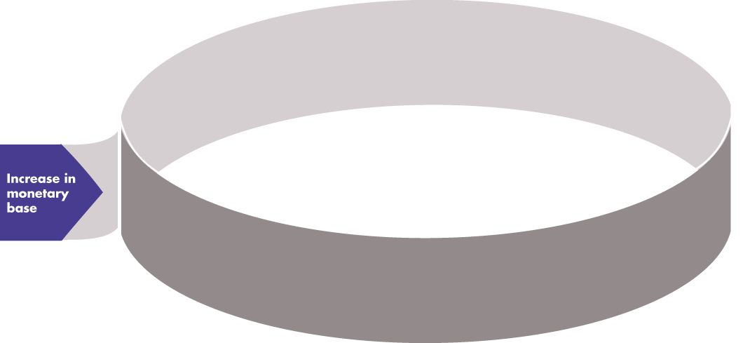
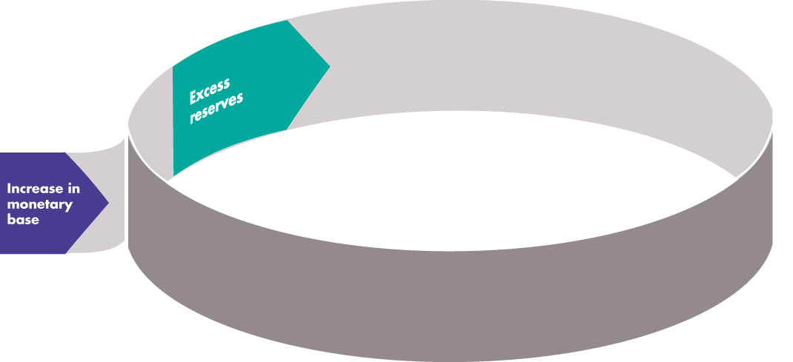
How Banks Create Money
Figure 8.3 illustrates one round in how the banking system creates money by making loans.

Slide 44
How Banks Create Money
The Money Multiplier
The money multiplier is the ratio of the change in the quantity of money to the change in the monetary base.
For example, if the Bank of Canada increases the monetary base by $100,000 and the quantity of money increases by $250,000, the money multiplier is 2.5.
The quantity of money created depends on the desired reserve ratio and the currency drain ratio.
The smaller these ratios, the larger is the money multiplier.
Notes:
Classroom activity
Check out Economics in Action: The Variable Money Multipliers

Slide 45
The Money Market
How much money do people want to hold?
The Influences on Money Holding
The quantity of money that people plan to hold depends on four main factors:
The price level
The nominal interest rate
Real GDP
Financial innovation
Notes:
It is worth reminding students that “money” has a jargon sense in economics; students are often confused by the phrase “demand for money” and it is worth tackling it head-on by emphasizing this does not equate to “wanting to be rich,” but refers to how much of total wealth (assets) the public want to hold in the particular form “money.” Students often try to understand ideas in terms of their own lives; few will make a clear connection between interest rates and demand for money from their own introspection. There are two ways to overcome this: one is to ask them to think in terms of extreme situations (get what short-term interest rates are in a high-inflation country); the other is to get them to imagine themselves in the job of treasurer of a corporation with large liquid resources, and to think how their behavior with respect to those funds might differ according to the short-term interest rates available.

Slide 46
The Money Market
The Price Level
A rise in the price level increases the quantity of nominal money but doesn’t change the quantity of real money that people plan to hold.
Nominal money is the amount of money measured in dollars.
Real money equals Nominal money ÷ Price level.
The quantity of nominal money demanded is proportional to the price level—a 10 percent rise in the price level increases the quantity of nominal money demanded by 10 percent.

Slide 47
The Money Market
The Nominal Interest Rate
The nominal interest rate is the opportunity cost of holding wealth in the form of money rather than an interest-bearing asset.
A rise in the nominal interest rate on other assets decreases the quantity of real money that people plan to hold.
Real GDP
An increase in real GDP increases the volume of expenditure, which increases the quantity of real money that people plan to hold.

Slide 48
The Money Market
Financial Innovation
Financial innovation that lowers the cost of switching between money and interest-bearing assets decreases the quantity of real money that people plan to hold.
The Demand for Money
The demand for money is the relationship between the quantity of real money demanded and the nominal interest rate when all other influences on the amount of money that people wish to hold remain the same.

Slide 49
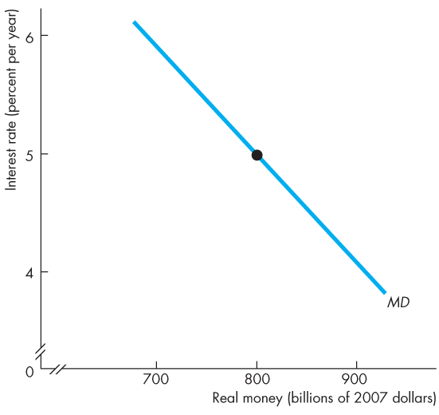
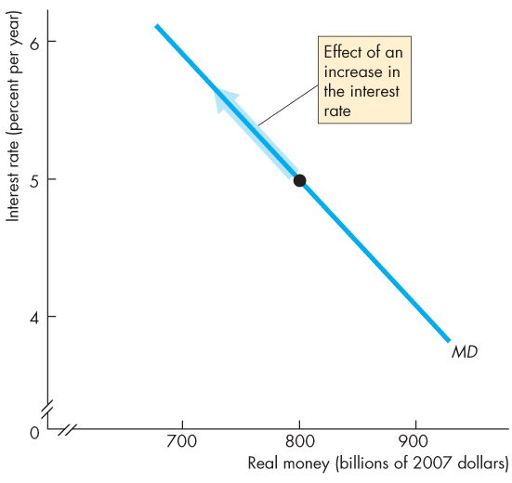
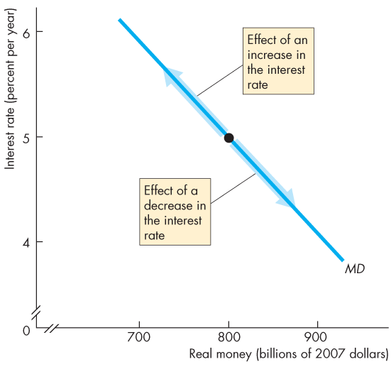

The Money Market
Figure 8.4 illustrates the demand for money curve.
A rise in the interest rate brings a decrease in the quantity of real money demanded.
A fall in the interest rate brings an increase in the quantity of real money demanded.

Slide 51
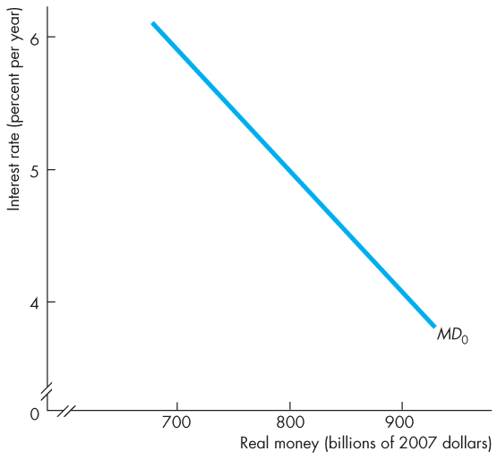
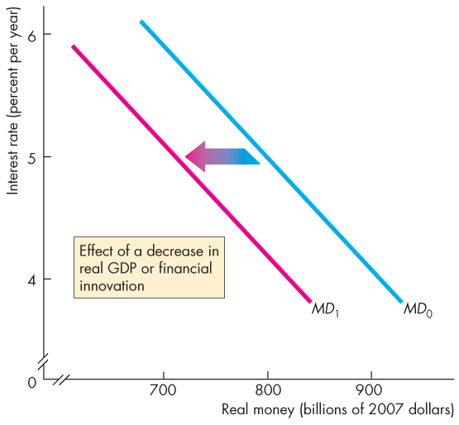
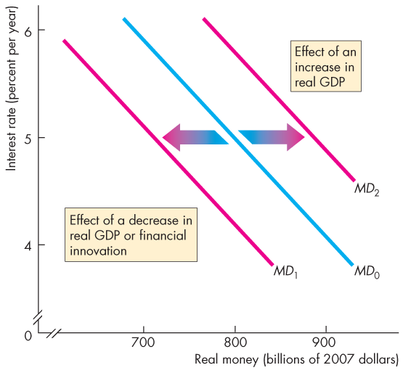

The Money Market
Shifts in the Demand for Money Curve
Figure 8.5 shows that a decrease in real GDP or a financial innovation decreases the demand for money and shifts the demand curve leftward.
An increase in real GDP increases the demand for money and shifts the demand curve rightward.

Slide 53
The Money Market
Money Market Equilibrium
Money market equilibrium occurs when the quantity of money demanded equals the quantity of money supplied.
Adjustments that occur to bring about money market equilibrium are fundamentally different in the short run and the long run.

Slide 54
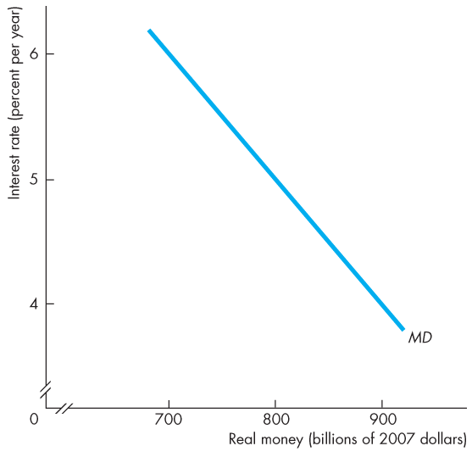
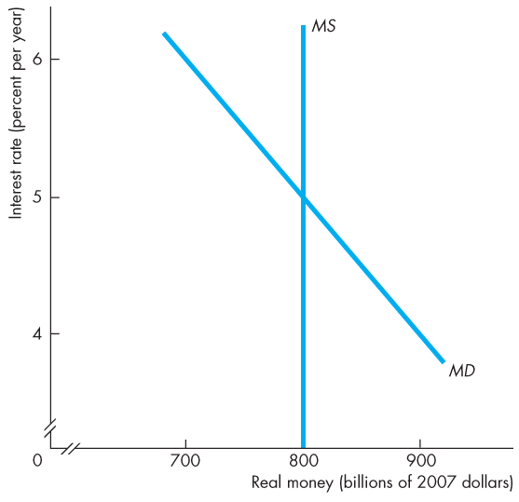
The Money Market
Short-Run Equilibrium
Figure 8.6 shows the demand for money.
Suppose that the Bank of Canada wants the interest rate to be 5 percent a year.
The Bank adjusts the quantity of money each day so that the quantity of real money is $800 billion.

Slide 55
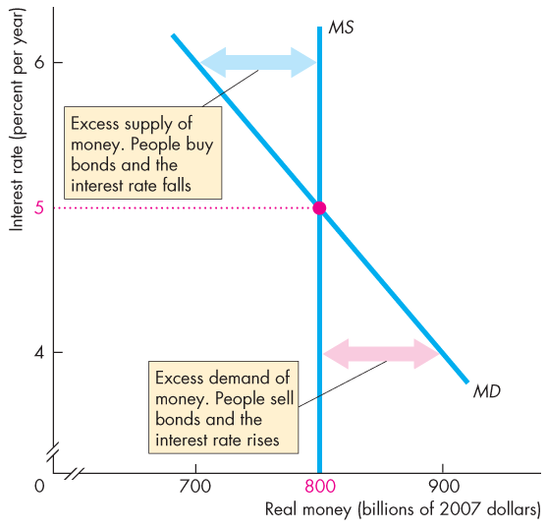
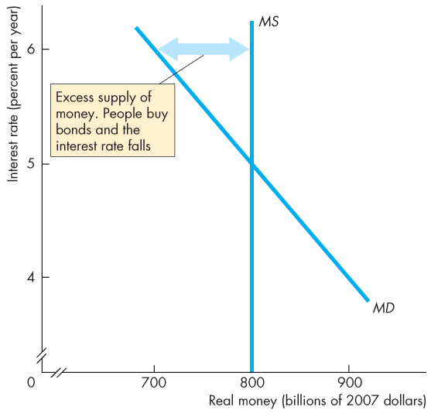


Slide 56
The Money Market
If the interest rate exceeds the 5 percent a year, …
the quantity of money that people are willing to hold is less than the quantity supplied.
They try to get rid of their “excess” money they are holding by buying bonds.
This action lowers the interest rate.

Slide 57
The Money Market
If the interest rate is below 5 percent a year, …
the quantity of money that people want to hold exceeds the quantity supplied.
They try to get more money by selling bonds.
This action raises the interest rate.

Slide 58
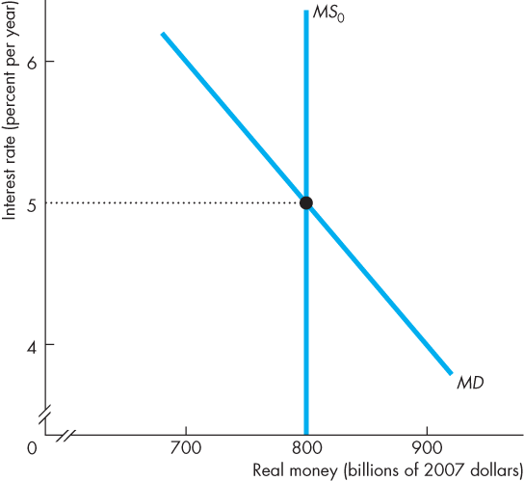
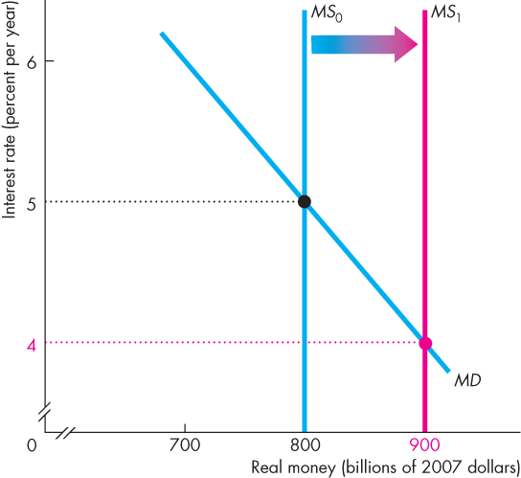
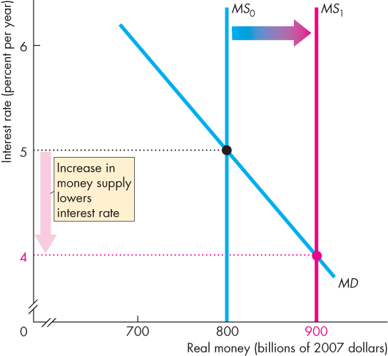
The Money Market
The Short-Run Effect of a Change in the Quantity of Money
Initially, the interest rate is 5 percent a year.
If the Bank increases the quantity of money, people will be holding more money than the quantity demanded.
So they buy some bonds.
The increased demand for bonds raises the bond price and lowers the interest rate.

Slide 59
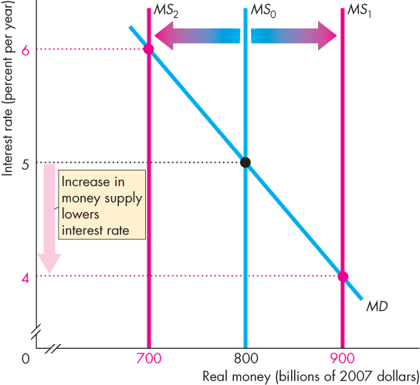
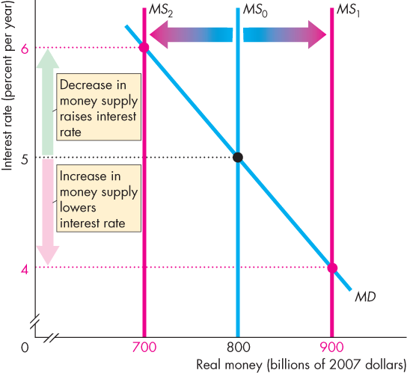

Slide 60
The Money Market
Initially, the interest rate is 5 percent a year.
If the Bank decreases the quantity of money, people will be holding less money than the quantity demanded.
So they sell bonds.
The increased supply of bonds lowers the bond price and raises the interest rate.

Slide 61
The Money Market
Long-Run Equilibrium
In the long run, the loanable funds market determines the real interest rate.
Nominal interest rate equals the equilibrium real interest rate plus the expected inflation rate.
In the long run, real GDP equals potential GDP, so the only variable left to adjust in the long run is the price level.

Slide 62
The Money Market
The price level adjusts to make the quantity of real money supplied equal to the quantity demanded.
If in long-run equilibrium, the Bank of Canada increases the quantity of money, the price level changes to move the money market to a new long-run equilibrium.
In the long run, nothing real has changed.
Real GDP, employment, quantity of real money, and the real interest rate are unchanged.
In the long run, the price level rises by the same percentage as the increase in the quantity of money.

Slide 63
The Money Market
The Transition from the Short Run to the Long Run
Start in full-employment equilibrium:
If the Bank of Canada increases the quantity of money by 10 percent, the nominal interest rate falls.
As people buy bonds, the real interest rate falls.
As the real interest rate falls, consumption expenditure and investment increase. Aggregate demand increases.
With the economy at full employment, the price level rises.

Slide 64
The Money Market
As the price level rises, the quantity of real money decreases.
The nominal interest rate and the real interest rate rise.
As the real interest rate rises, expenditure plans are cut back and eventually the original full-employment equilibrium is restored.
In the new long-run equilibrium, the price level has risen 10 percent but nothing real has changed.

Slide 65
The Quantity Theory of Money
The quantity theory of money is the proposition that, in the long run, an increase in the quantity of money brings an equal percentage increase in the price level.
The quantity theory of money is based on the velocity of circulation and the equation of exchange.
The velocity of circulation is the average number of times in a year a dollar is used to purchase goods and services in GDP.
Notes:
Velocity of circulation. Emphasize that velocity is defined by the equation V = PY/M, and is not the average number of times a given piece of paper changes hands in a year. Nor is V the transactions velocity because most transactions are not payments for goods and services. (Transactions are twice PY because they also include payments for the services of factors of production, which equals PY, plus all the purely financial transactions such as buying and selling stocks, bonds, foreign currency, and real estates.)
The quantity theory of money. Given that V is defined as PY/M, the equation of exchange, MV = PY is an identity. The quantity theory is not the equation of exchange but the propositions that (1) V is independent of M and (2) Y equals potential GDP, which is independent of M. Given these assumptions, the inflation rate equals the growth rate of the quantity of money.
The quantity theory of hyperinflation. A possible exercise is to ask students whether we would expect the correlation between money growth and inflation to remain strong in a hyperinflation. Most will see that in a hyperinflation, velocity will increase. Emphasize that the level of velocity is greater in hyperinflation but if the inflation rate remains constant (and high) velocity also is constant (and high), so the quantity theory still holds. It does not hold in the move from low inflation to high inflation. The inflation rate overshoots the growth rate of the quantity of money.

Slide 66
The Quantity Theory of Money
Calling the velocity of circulation V, the price level P, real GDP Y, and the quantity of money M:
V = PY ÷ M.
The equation of exchange states that
MV = PY.
The equation of exchange becomes the quantity theory of money if M does not influence V or Y.
So in the long run, the change in P is proportional to the change in M.

Slide 67
The Quantity Theory of Money
Expressing the equation of exchange in growth rates:
Money growth rate + = Inflation rate + Rate of velocity change Real GDP growth
Rearranging:
Inflation rate = Money growth rate + Rate of velocity change − Real GDP growth
In the long run, velocity does not change, so
Inflation rate = Money growth rate − Real GDP growth
Notes:
Classroom activity
Check out Economics in Action: Does the Quantity Theory Work?
Classroom activity
Check out Economics in the News: Money and the Economy

Slide 68
Mathematical Note: The Money Multiplier
To see how the process of money creation works, suppose that the desired reserve ratio is 10 percent and the currency drain ratio is 50 percent of deposits.
The process starts when all banks have zero excess reserves and the Bank of Canada increases the monetary base by $100,000.
The figure in the next slide illustrates the process and keeps track of the numbers.
Notes:
A money creation experiment. The process through which banks “create money” can be a dark and mysterious secret to the students. Indeed, even though the text contains a superb description of the process, students still manage to end up confused. The first prerequisite to students understanding the process is that they be comfortable with balance sheets shown in the form of T-accounts, and it is well worth spending time on them to make sure students understand what they are and what they show. This will be the first time some students have ever had to interpret a balance sheet, and it is key that they understand that assets are what are owned, liabilities are what are owed, by the institution for which the balance sheet is constructed; and that the two sides must balance. Mark Rush (our U.S. study guide author and supplements czar) tackles the problem of getting students to understand bank money creation head-on by (again) involving the class in a demonstration. Prepare by decorating a piece of green paper with currency-like symbols. (For instance, Mark draws a seal and around it write “In Rush We Trust.” You may write the same slogan, but substituting your name for his probably will be more effective; an alternative is to use “play money”). Label this piece of paper a “$100 bill.” In class use one of the students by handing him the bill. Tell him that he has decided to deposit it in his bank and ask him his bank’s name. On the chalkboard draw a balance sheet for the bank with deposits of $100, reserves of $10, and loans of $90. Tell the students that the required reserve ratio is 10 percent, so this bank currently has no excess reserves. Now, instruct the student to deposit the money in his bank, which coincidentally happens to be run by the student next to him. Show the class what happens to the balance sheet and how the bank now has excess reserves of $90. Clearly the “banker” will loan these reserves to the next student in the class, who wants a $90 dollar loan so she can take a bus ride to some nearby dismal location. (Being located in Gainesville, Florida, Mark picks on the city of Stark, home to Florida’s electric chair and a town with an apt name.) When the loan takes place, rip the $100 bill so that only about nine tenths of it is given as the loan. This student pays the money to Greyhound—coincidentally the next student. Ask the name of Greyhound’s bank and draw an initial balance sheet for this bank identical to the initial balance sheet of the first bank. Greyhound deposits the money in the bank—the next student in the row. Work with the balance sheets to show what happens to the first bank and what happens to the second bank. Clearly the first one no longer has excess reserves but the second bank now has $81 of excess reserves ($90 of additional deposits minus $9 of required reserves). The second bank will make a loan, which you can act out with more students in the class, again ripping off nine tenths of the remaining bill. Work through the point where the second loan winds up deposited in a third bank and then stop to take stock. At this point the quantity of money has increased by $90 in the second bank and $81 in the third, for a total increase—so far—of $171. The students will clearly see that this loaning and reloaning process is not yet over and that the quantity of money will increase by still more. Moreover (and more important) the students will grasp how banks “create money.”

Slide 69
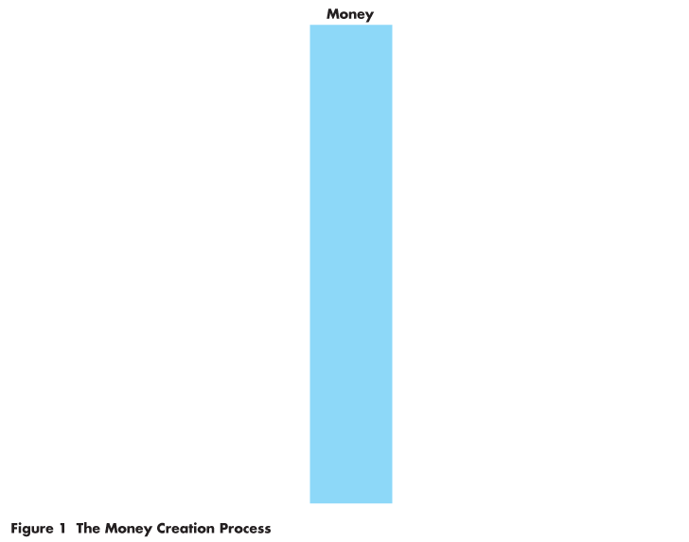
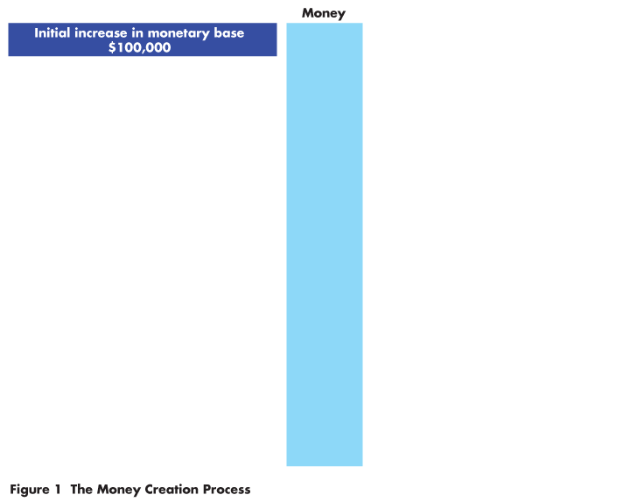
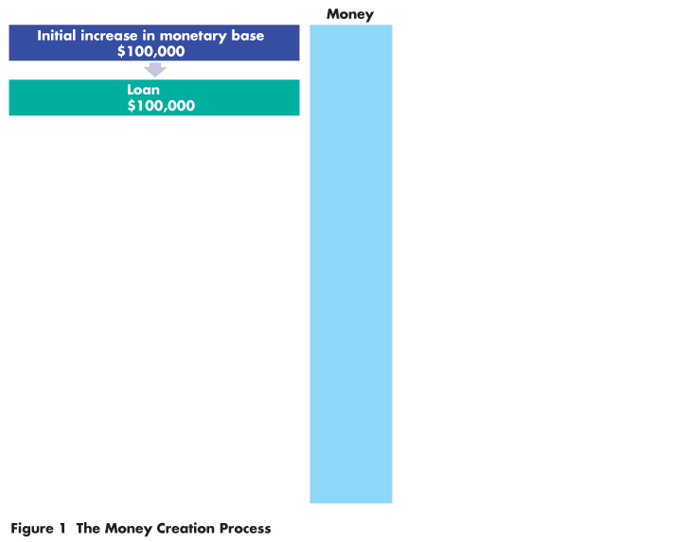
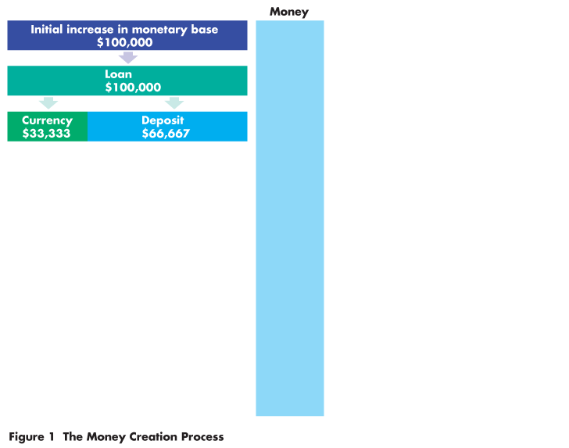
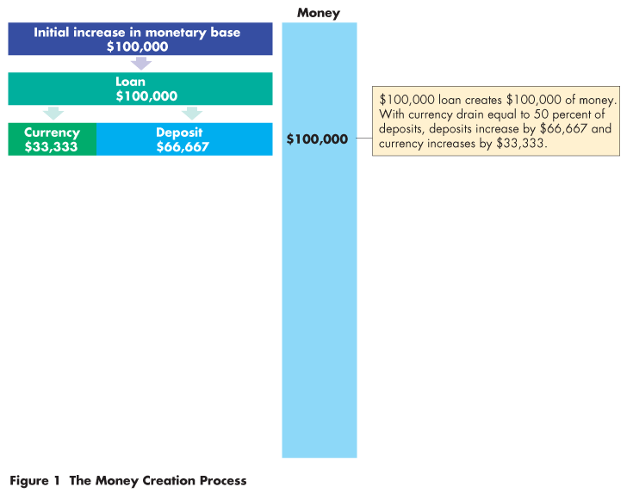
Mathematical Note: The Money Multiplier
The bank with excess reserves of $100,000 loans them.
Of the amount loaned, $33,333 drains from the bank as currency and $66,667 remains on deposit.
Currency drain is 50 percent of deposits.

Slide 70
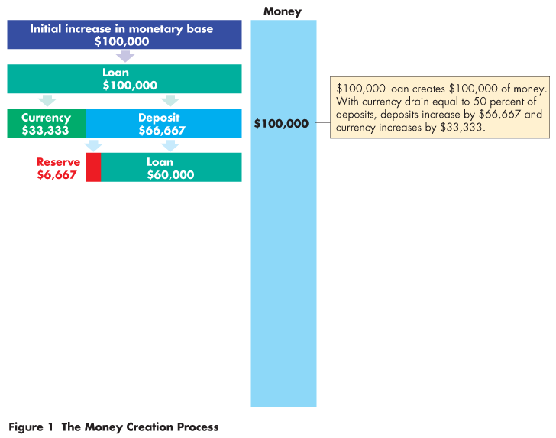
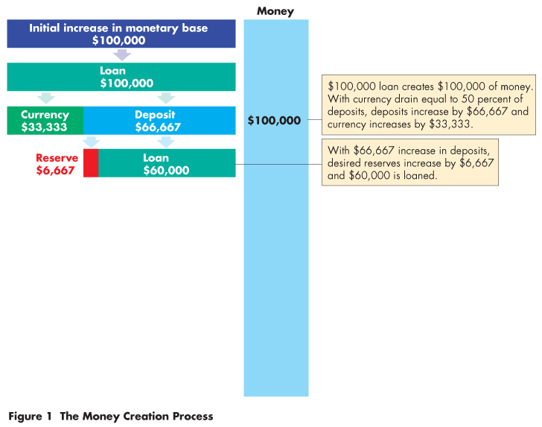
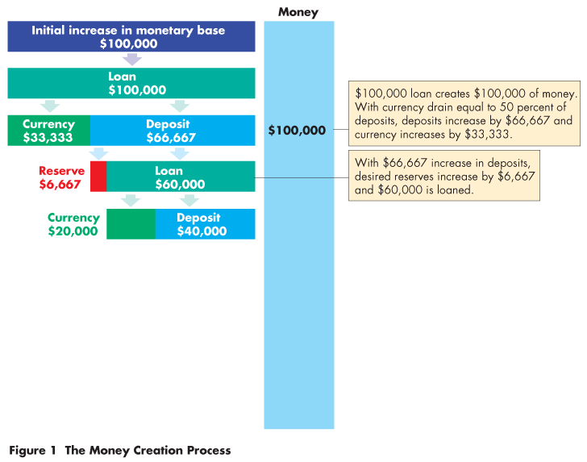
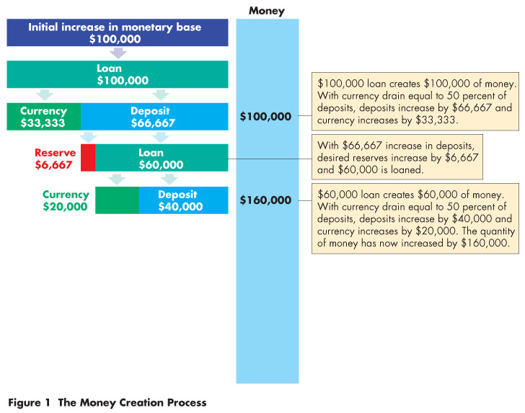

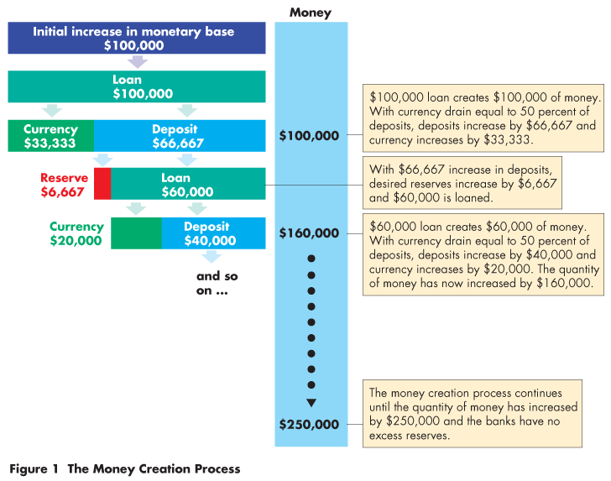

Slide 71
Mathematical Note: The Money Multiplier
The bank’s reserves and deposits have increased by $66,667,
so the bank keeps $6,667 (10 percent of deposits) as reserves and loans out $60,000.

Slide 72
Mathematical Note: The Money Multiplier
$20,000 drains off as currency and $40,000 remains on deposit.
Again, the currency drain is 50 percent of deposits.

Slide 73
Mathematical Note: The Money Multiplier
The process repeats until the banks have created enough deposits to eliminate the excess reserves.
The $100,000 increase in monetary base has created $250,000 of money.

Slide 74
Mathematical Note: The Money Multiplier
The size of the money multiplier depends on
The currency drain ratio (C/D)
The desired reserve ratio (R/D)
Money multiplier = (1 + C/D)/(C/D + R/D)
In our example, C/D is 0.5 and R/D is 0.1, so
Money multiplier = (1 + 0.5)/(0.1 + 0.5)
= (1.5)/(0.6)
= 2.5

